Slide 1
Embedded Web Service Development
Embedded SOAP Server
อาจารย์ที่ปรึกษา ผศ.อภิเนตร อูนากูล
ผู้จัดทำโครงงาน นายธเนศ ชูวิเศษวณิชย์
นายธีรยุทธ สุทธิสุวรรณ

Slide 2


Agenda
Overview
  Background
  Objective
  Goal
  Benefit
Scope of Project
  Related Technology
  Design
Progress

Slide 3


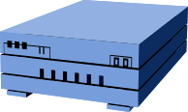
Managing Ubiquitous Device
Project Overview
Embedded Web Service
Device
16 bit device
Network
Management Station
PC based

Slide 4

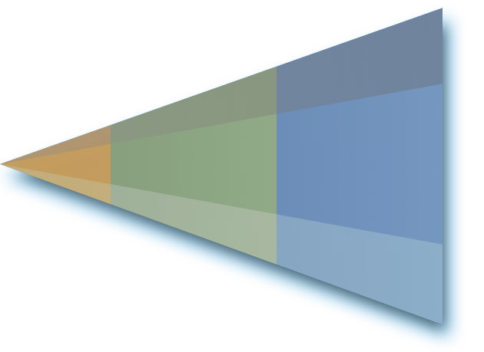

Background
XML
HTML
TCP/IP
Technology
Standard
Connectivity
Presentation
Programmability
Innovation
FTP, E-mail, Gopher
Web Pages
Browse
the Web
XML Web Services
Program
the Internet

Slide 5


Background
We want to Communicate between application
SOAP (Simple Object
Access Protocol)
  Distributed Object Framework
  Open Standard Protocol
  Design for use with HTTP
  Use XML Structure
  Can be used complicated method
  Messaging between application

Slide 6

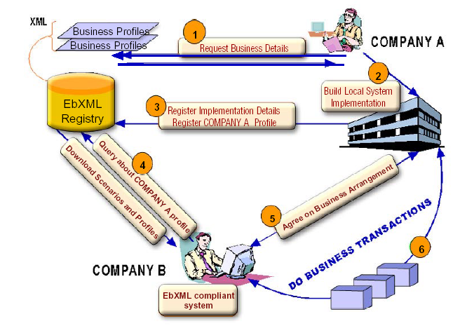
Background
Web Service

Slide 7
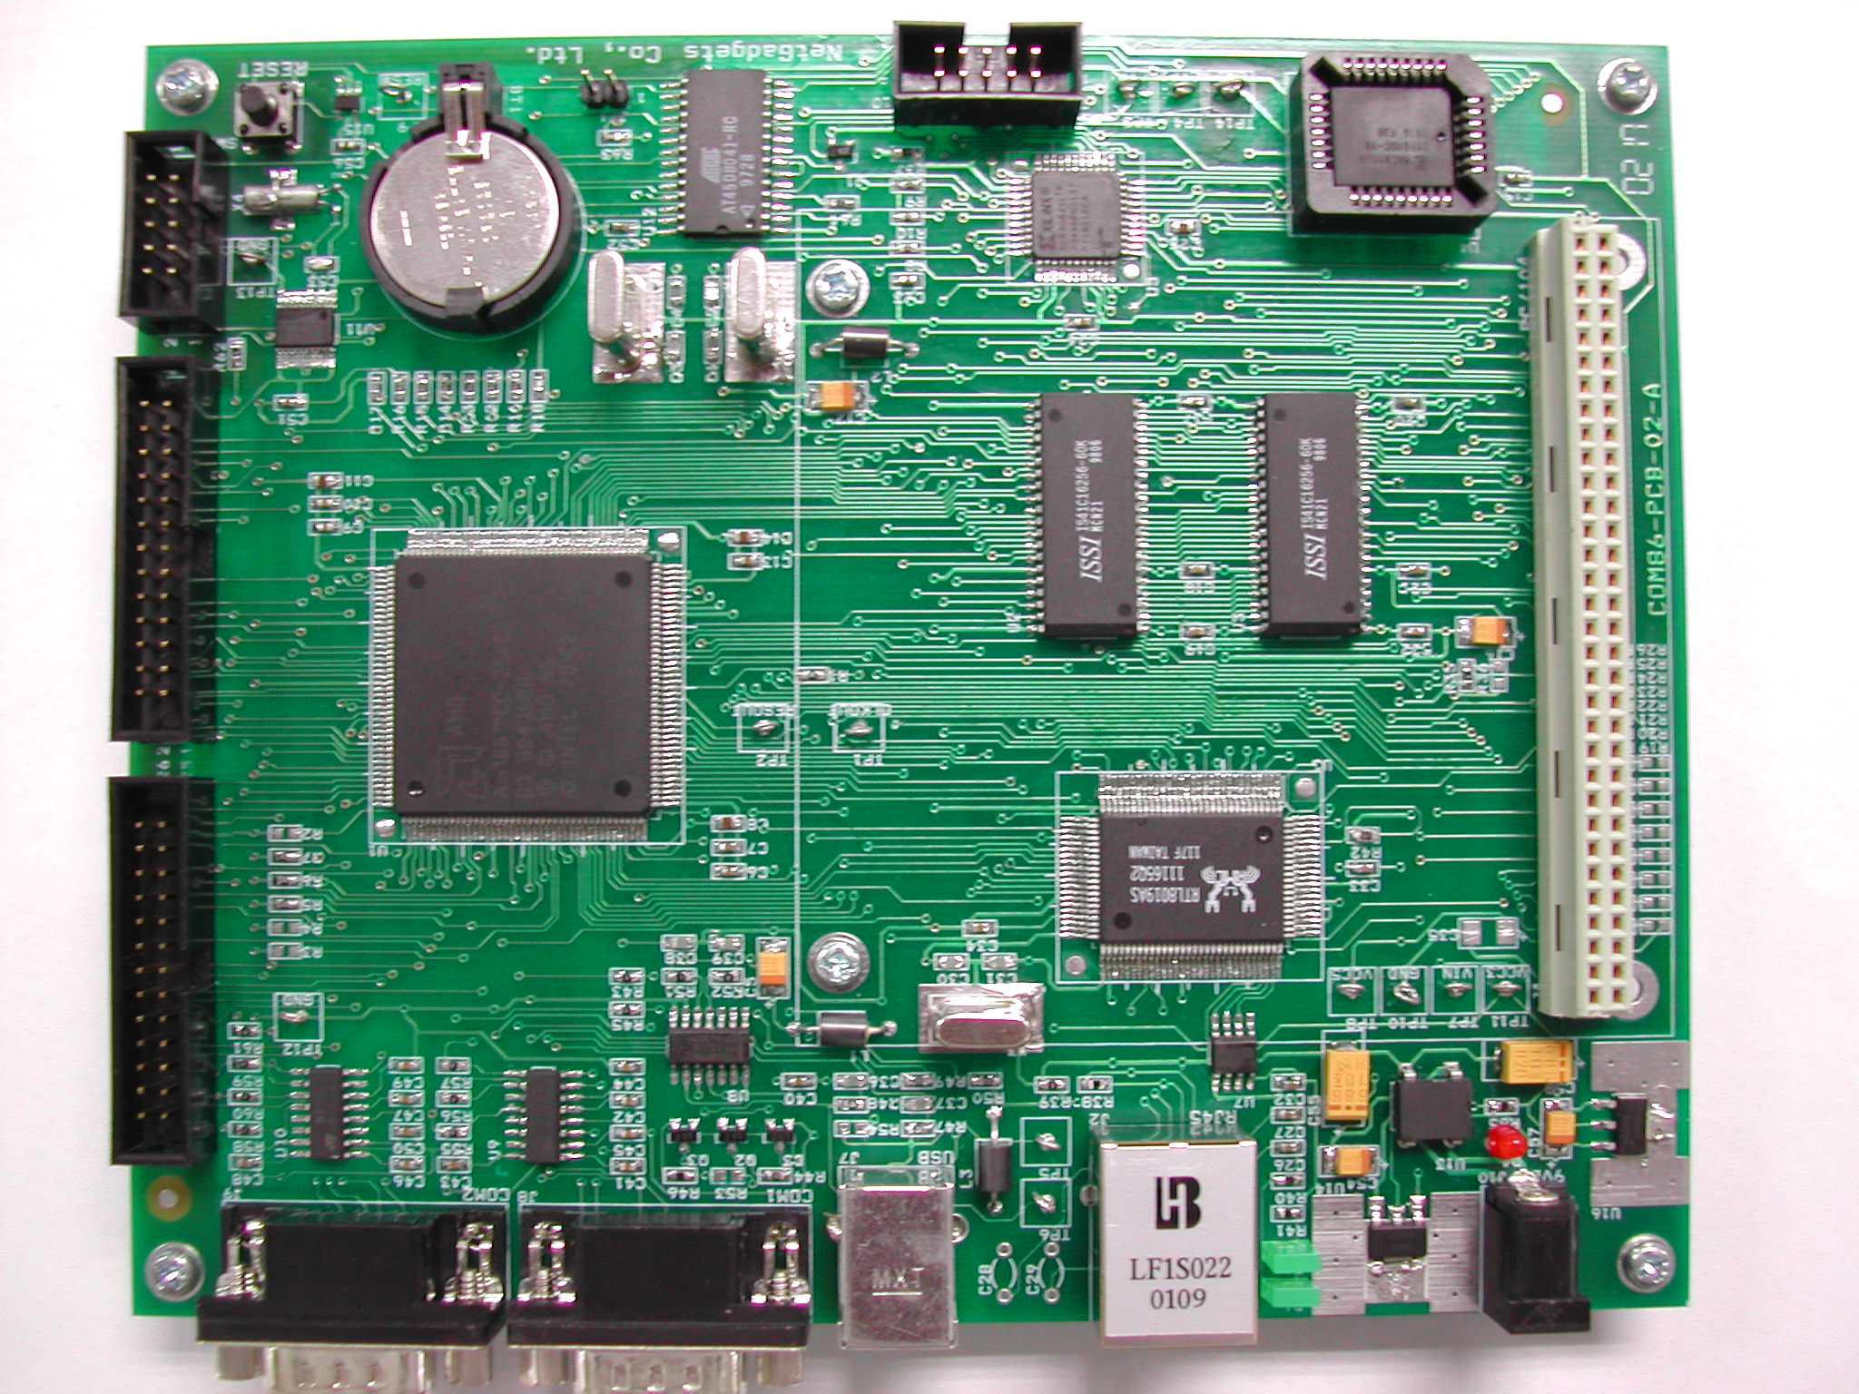
Background
Com86
Why Embedded?
  Environment in work
  Reduce Cost
  Support OS & TCP/IP Stack
  Many Interface to connect devices
  Support in Thailand

Slide 8

Background
Embedded Web Service
  No Commercial EWS today !!!
  Open Source Project
    eSOAP (under development)
      For 32-bit Processors
      Difficult to port down on 8,16 bit

Slide 9



Background
Embedded Web Service Development
Project’s 45
Mr. Suwit
Mr. Akekarach
Embedded Web Service Library Package

Slide 10

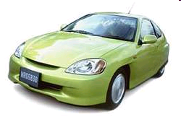

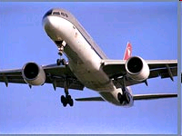

Background
Real-Time in Real-World

Slide 11
Project Proposal

Slide 12
Objective
Modify Embedded Web Service to
Real-time & Multi-Task processing
Developing Framework for Web Service Developer Easy to Implement

Slide 13
Goal
Embedded SOAP Server Library Package
Framework for implement Web Service

Slide 14
Related Technology

Slide 15
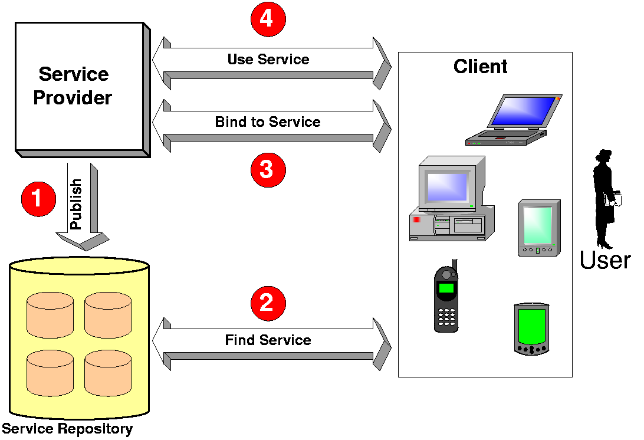
Web Service Overview

Slide 16

Web Service Overview
Web Service
Open
Internet
Protocols
UDDI
Universal Description,
Discovery, and Integration
WSDL
Web Services
Description Language
SOAP
XML & HTTP

Slide 17
Web Service Overview
SOAP
UDDI
Service Publication / Discovery
SOAP (Simple Object Access Protocol)
provides a simple and lightweight mechanism for exchanging structured and typed information
WSDL
Service Description
SOAP
XML-based Messaging
HTTP
Network

Slide 18
Web Service Overview
WSDL
UDDI
Service Publication / Discovery
WSDL (Web Service Description Language)
define Web services and describe how to access them.
WSDL
Service Description
SOAP
XML-based Messaging
HTTP
Network

Slide 19
Web Service Overview
UDDI
UDDI (Universal Description, Discovery,
and Integration)
is provide method for to built and find the detail of Web Services.
business and data of services
UDDI
Service Publication / Discovery
WSDL
Service Description
SOAP
XML-based Messaging
HTTP
Network

Slide 20
Embedded Web Service : Project’s 45
Context Diagram
Service
Code
Service
Code
Client
Application
Client
Application
Embedded
Web Service
Register
Embedded
Web Service
Communication
Communication
UDDI
Registry
UDDI
Registry

Slide 21
Embedded Web Service : Project’s 45
Architecture
Service Code
Service Code
Service Code
Service Code
SOAP
Service Code
XML
HTTP
TCP/IP

Slide 22
Embedded Web Service : Project’s 45
Structure Diagram
Service
Code
Embedded
Web Service
SOAP
Handler
XML
Parser
Embedded
SOAP Server
SOAP
Object

Slide 23

Real-Time System
What is Real-Time System?
System that respond to external events
  in real time.
  Hard real-time
  Soft real-time

Slide 24

Real-Time System
Why is Real-Time for Embedded System?
  Time Constraints
  Safety
  Interrupt Service Routines
  Optimization Performance

Slide 25
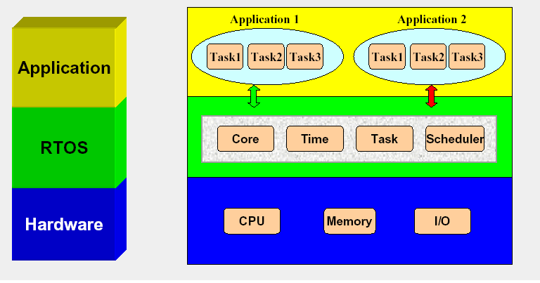
Real-Time System
Real-Time Kernel

Slide 26

Real-Time Kernel
μC/OSII
Feature
  Preemptive Kernel
  Multi-Tasking
  Deterministic
  Interrupt Management
  Intertask Communication
  Robust & Reliable
  Portable
  Open Source & Free !!

Slide 27
Real-Time Kernel : programming
Task
Main function
void YourTask (void *pdata)
{
/* Task init */
for( ; ; ){
/* User Code */
}
}
void main (void)
{
OSInit();
/* other global init */
OSTaskCreate(YourTask1 , …);
OSTaskCreate(YourTask2 , …);
OSTaskCreate(YourTask3 , …);
OSTaskCreate(YourTask4 , …);
: :
OSStart();
}

Slide 28
Real-Time Application
Independent
Same Objective
Obj A
Obj B
Obj C
Obj E
Task1
Task2
Task3
Obj D
Obj F
Obj G
Kernel
Obj H
Application
Application

Slide 29
Design

Slide 30

Embedded Web Service : Project’s 45
Serverd.exe
SOAPServ.exe
Service
eg. Calculator
HTTP

Slide 31
Embedded Web Service : Project’s 45
Serverd.exe
  HTTP Request
  HTTP Response
  TCP/IP Stack Module
HTTP Request
HTTP
Encoder
/
Decoder
TCP/IP
Stack
SOAP Message
HTTP Response

Slide 32
Embedded Web Service : Project’s 45
SOAPServ.exe
  SOAP Parser
  SOAP Enveloper
  SOAP Deserializer
  SOAP Serializer
SOAPServ
Call Service Method
Service Parameters
SOAP Message
Service Result

Slide 33
Embedded Web Service : Project’s 45
Service application (calculator.exe)
  Simple program
  Example
operand
Calculator
result
operation

Slide 34
Embedded Web Service : Project’s 45
spawnl() : to call the next
  creates and executes a new child process
Process1
Process2
spawnl()

Slide 35
Embedded Web Service : Project’s 45
Soap.txt
Output.txt
http response
4
3
Serverd
SOAPServ
Service
spawnl()
spawnl()
1
2
http request
Soap.txt
Input.txt

Slide 36
Embedded Web Service : Project’s 45
Operational Constraints
  Single request per 1 time processing
  Another request must be in queue
  Service Latency = System Latency
  No intertask communication
  No priority

Slide 37
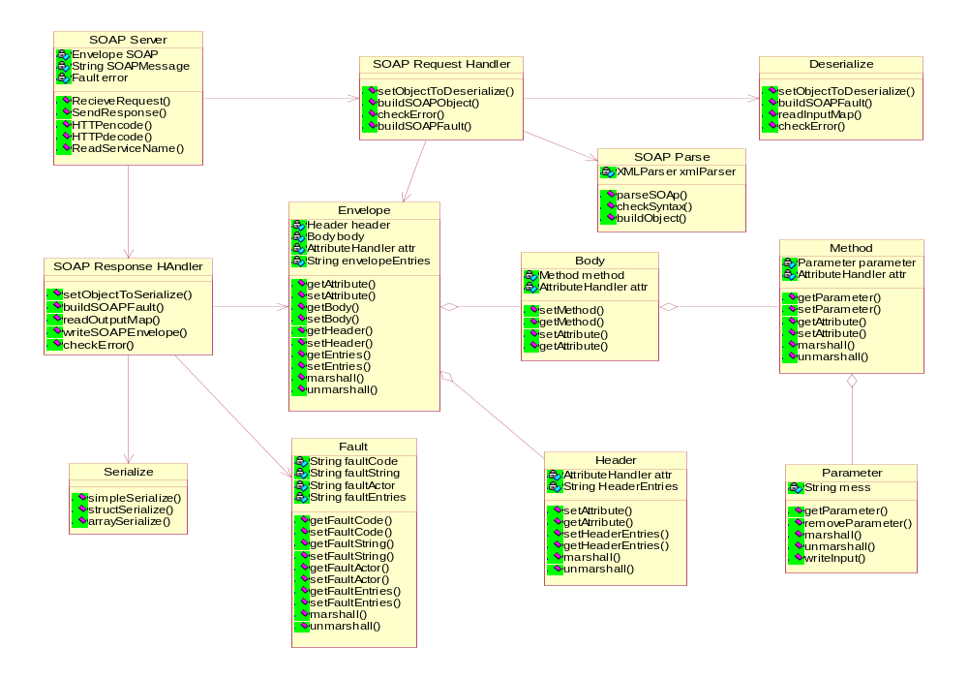
Restructure

Slide 38
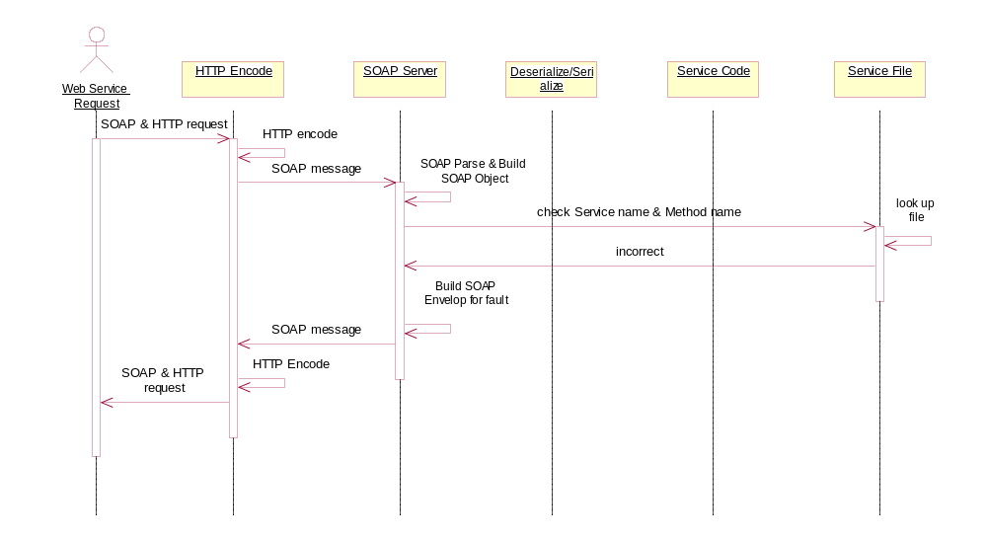
Restructure

Slide 39
Restructure
HTTP Encoder
Service1
SOAP Parser
Service2
SOAP Deserializer
Service3
Service4
SOAP Serializer
Service5
SOAP Enveloper
HTTP Encoder

Slide 40
Real-Time Web Service
Architecture
HTTP Request
Message
HTTP Response
Message
HTTP
Decoder
SOAP
Parser
SOAP
Deserializer
Service1
SOAP
Serializer
SOAP
Envelop
HTTP
Encoder
TCP Stack
TCP Stack
Service2
.
.
.
Service50
Message Mailboxes & Event Control
Real-Time Kernel (uC/OSII)
Operating System (DOS)
Hardware (COM86)

Slide 41
Real-Time Web Service
Design Structure
Kernel
Configuration
Web Service
Developer
HTTP Decoder
Kernel
interface
SOAP Parser
Service 1
SOAP Deserializer
SOAP Serializer
interface
Service 2
SOAP Enveloper
HTTP Encoder
interface
Service 3

Slide 42
Framework
Web Service
Developer
Service
template
Kernel
Configuration
template
Interface
template
Service
Interface
Embedded SOAP Server Package
Kernel
Configuration
Compile & Build

Slide 43
Real-Time Web Service
Benefit
  More than 1 requests per 1 time processing
  Priority Assignable
  Increase System Utilization
  Intertask Communication

Slide 44
Progress
1st Semester Plan
  Study and Reverse Engineering
  Real-Time Concept
  Design Scope of Project
  Design Architecture & Structure
1st Semester Deliverable
  Project Proposal
  Technology Report
  Architecture

Slide 45
Progress
2nd Semester Plan
  Modifying and Porting
  Additional Programming
  Module Testing
  Design Framework
  Integrate & System Testing
2nd Semester Deliverable
  Embedded SOAP Server Library Package
  Web Service Development Framework
  Documentation

Slide 46

Q & A

